Slide 1
Linux-Basic Overview and Commands
OCC Engineering team
Saumya Ahuja

Slide 2
Agenda
1
Introduction to Linux OS
2
Useful Commands
3
File Permissions
4
Vim Editor
5
Q & A

Slide 3
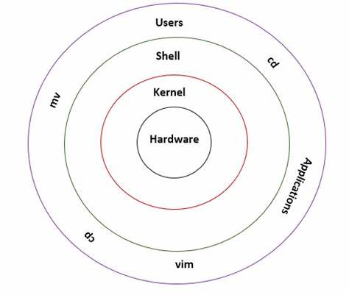
Introduction to Linux
Linux is a powerful and popular operating system that is based on the Unix operating system. It is known for its stability, security, and flexibility. Linux is open-source, meaning that its source code is freely available and can be modified and distributed by anyone
Linux is widely used in various domains, including servers, embedded systems, and personal computers. It has a vast software ecosystem, with thousands of free and open-source applications available for installation. Linux also offers strong security features, with regular updates and a robust permission system

Slide 4
Advantages of Linux OS
Open-source: Linux is an open-source operating system, which means its source code is freely available for anyone to use, modify, and distribute
Stability and reliability: Linux is known for its stability and reliability
Security: Linux is inherently more secure than many other operating systems
Customization and flexibility: Linux offers a high degree of customization and flexibility
Wide software compatibility: Linux supports a vast array of software applications and development tools
Cost-effective: Linux is typically available for free, which significantly reduces operating system costs, especially for organizations that require multiple installations
Community support: The Linux community is vibrant and supportive
Scalability: Linux scales well from small devices to large-scale enterprise systems
These advantages have contributed to the widespread use of Linux in various domains, including web servers, supercomputers, embedded systems, mobile devices, and desktop computers

Slide 5

Linux OS Various Flavors
Below are most used flavors of Linux :
Ubuntu is a popular Linux distribution that is designed to be easy to use. It is based on Debian and is one of the most widely used Linux distributions for desktop and laptop computers
Fedora is a community-driven Linux distribution that is sponsored by Red Hat. It is known for its cutting-edge technology and its focus on free and open-source software
Debian is a stable and reliable Linux distribution that is used by many people as a server operating system. Debian is also a popular choice for desktop computers and laptops, especially for those who value stability over cutting-edge technology
CentOS is a community-driven Linux distribution that is based on Red Hat Enterprise Linux. It is known for its stability and security and is widely used as a server operating system
Redhat Enterprise Linux is one of the relatively old Linux, offering convenience, a fully graphical display mode starting at installation, and friendly usage

Slide 6
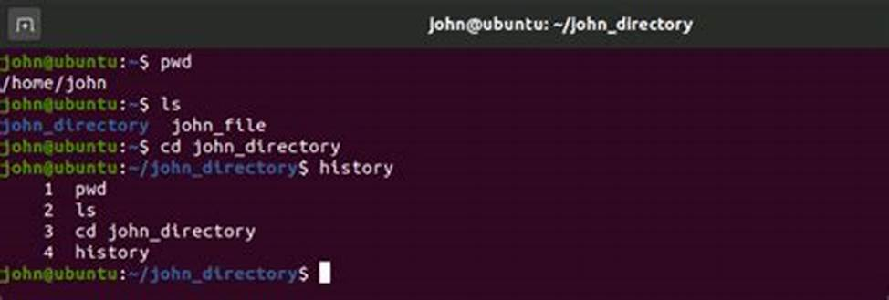
Introduction to Linux CLI
The Linux Command-Line Interface (CLI) is a way to interact with the Linux operating system using text commands typed into a special window called a terminal
Allows users to execute commands by manually typing at the terminal or can automatically execute commands which were programmed in “Shell Scripts”

Slide 7
File System Management Commands
Command | Description | Syntax
touch | To create empty files | # touch file1
rm | To remove the file | # rm file
cat | To read a file /show the content of the file | # cat /etc/passwd
chown | Changing ownership of a file | # chown <new user/owner name> <filename>
chmod | How to change the file permissions | chmod rwx /file or # chmod 666 /mydir
head | To show the first 10 list of the file | # head /etc/passwd
tail | To show the first 10 list of the file | # tail /etc/passwd
find | To search the files | find
pwd (print working directory) | pwd command return with present working directory | # pwd
ls | ls command display list of files in human readable format. | # ls -l
cd (change directory) | with cd command (change directory) it will goes to DVD directory. | # cd /DVD
mkdir | mkdir command is used to create directories under Linux. | # mkdir directoryname
cp | Copy file from source to destination preserving same mode. | # cp -p fileA fileB
mv | Rename fileA to fileB. -i options prompt before overwrite. Ask for confirmation if exist already. | # mv -i fileA fileB

Slide 8
File System Management Commands (Continued)
Command | Description | Syntax
echo | echo command is very simple: it echoes the input that it receives. | # echo Sky is blue Sky is blue
grep | To find a word into a file | # grep -i abc /etc/passwd abc:x:500:500:abc:/home/abc:/bin/bash # cat /etc/passwd | grep -i abc abc:x:500:500:abc:/home/abc:/bin/bash
rm | Remove files/Folders | rm test.txt
wc | To Count words in a file | cat test.txt | wc -l

Slide 9
System information/Management related Commands
Command | Description | Syntax
date | The date command can display the date, time, time zone and more. | date
Whoami Command | whoami command print the name of current user. You can also use “who am i” command to display the current user. | Whoami Command
Process Management Command | ps Displays information about running processes kill Terminates a process pgrep Finds a process based on its PID pidof Displays all processes related to a service or command top Monitors system resources (similar to Task Manager in Windows) renice Adjusts the priority of a particular process | Process Management Command
uname utility | It tells the host info, hostname, OS, kernel etc - # uname -a (all info) # uname -n (hostname) # uname -r (kernel version) # uname (Operating system) # uname -p (hardware architecture 32bit/64it) # uname -m (OS architecture 32bit/64it) | uname utility

Slide 10
User/Group Management Commands
Command | Description | Syntax
useradd | To add/create a user | # useradd <username> # useradd test1
passwd | Set password to a user account | passwd <username>
su | Switch User Account | su <username>
userdel | Delete user account | userdel <username>
usermod | Change user account name | usermod -l <new_name> <old_name>
id | To get user ID Information | id <username>
groupadd | Add group account | groupadd [group-name]
groupdel | Remove group account | groupdel [groupname]
gpasswd | Add/Remove Members in group | gpasswd [options] [username] [groupname] -a add single member -M add multiple members -d remove member

Slide 11
Network Management Commands
Command | Description | Syntax
ifconfig | To check the NIC details | # ifconfig # ifconfig –a # ifconfig eth0
ping | To check the network connnectivity | # ping 192.168.XXX.XXX
traceroute | prints out complete route to a particular destination | traceroute <Destination hostname/IP/Or any website name>
nslookup | tool for testing and troubleshooting DNS servers | nslookup 209.191.122.70 nslookup yahoo.com
netstat | Examine network statistics | netstat <options>

Slide 12
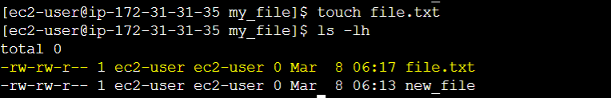
File Permissions
The 3 levels of permission in Linux
Owner: This group gives members complete control over a file
Group: You can assign a group of users to a file or directory and give the group a specific set of permissions
All users: This permission group applies to all other users
The 3 permission types on Linux
On Linux, there are three types of permissions for files and directories:
r: The read permission means that the file/directory is readable
w: The write permission means that the file/directory can be modified
x: The execute permission means that a user or group can execute a file

Slide 13
Vim Editor
The name Vim is an acronym for Vi Improved. This editor is an enhanced version of the Vi text editor that we all know and love and is normally seen in a CLI form.
The Vim editor has three modes that determine how the editor functions: Normal (or Command), Insert, and GUI.
Normal mode allows you to give commands to the editor. Functions such as the following can be found here
:w to write/save.
:q to quit.
:w <filename.txt> to name a new file.
:q! to quit without saving the changes to the file
Insert mode
If you have made it this far, you probably know what the Insert mode does. However, for those who don't, if you press the I key (lowercase i) once you will see the "INSERT" prompt at the bottom of the screen, indicating that you can now edit or add text
GUI mode
GUI mode is only available in some environments. It offers a graphical, point-and-click interface to be utilized with a mouse and keyboard

Slide 14
Q&A

